Slide 1

Network Topologies
By
Dr Sanjeev Kumar Mandal

Slide 2
What is topology?
A physical arrangement of computer systems or nodes that are connected through communication media is called topology.
There are six different types of topology:

Slide 3
Topologies
Types
Bus
Ring
Star
Tree
Mesh
Hybrid

Slide 4
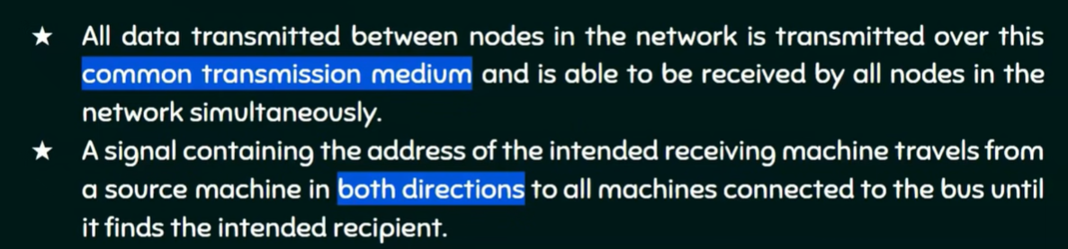
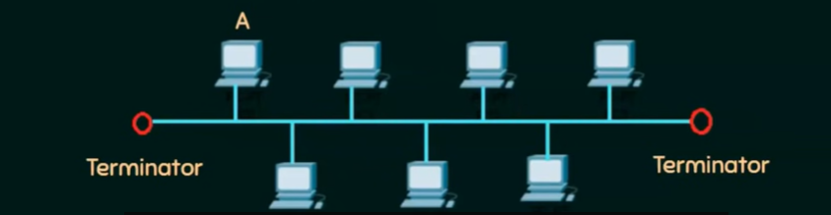
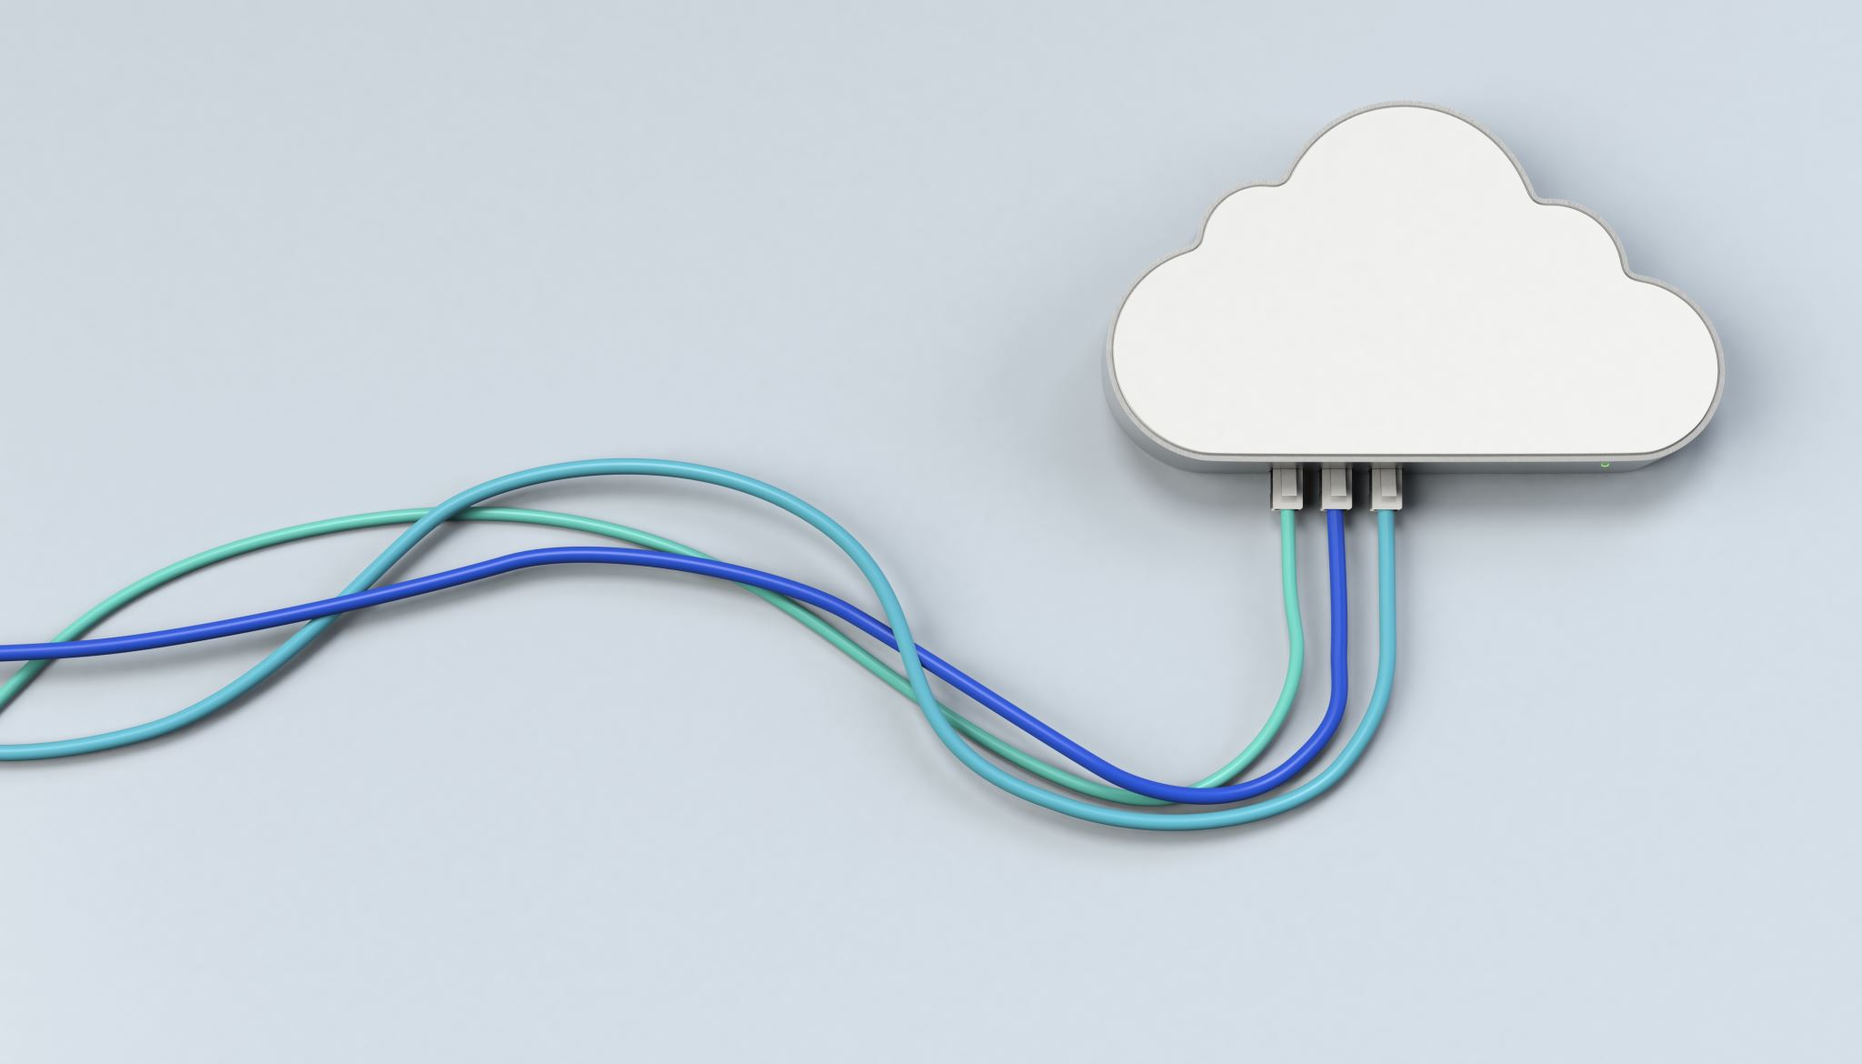
Bus Topology

Slide 5
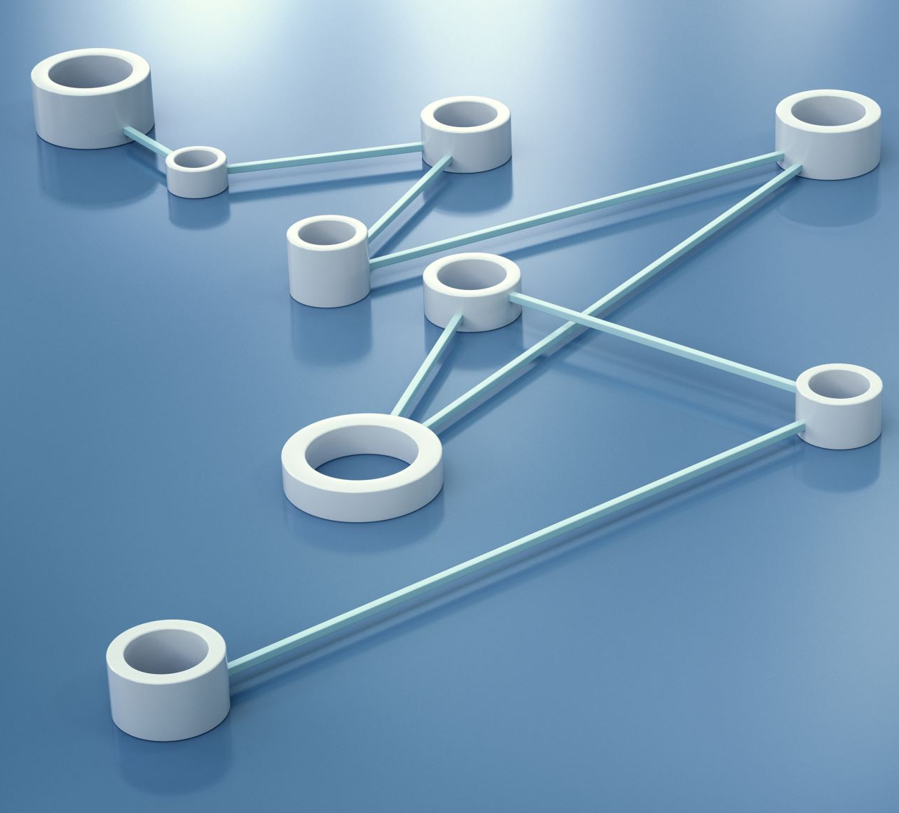
Advantages
It works well when you have a small network.
It's the easiest network topology for connecting computers or peripherals in a linear fashion.
It requires less cable length than a star topology.
Less Expensive
If one computer fails to work it will not affect other computers.

Slide 6

Disadvantages of bus topology
It can be difficult to identify the problems if the whole network goes down.
It can be hard to troubleshoot individual device issues.
Bus topology is not great for large networks.
Terminators are required for both ends of the main cable.
Additional devices slow the network down.
If a main cable is damaged, the network fails or splits into two.

Slide 7
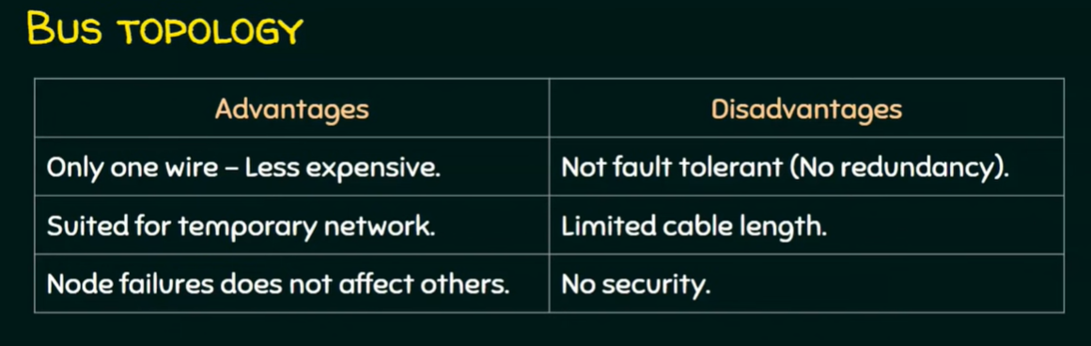
Cont..

Slide 8
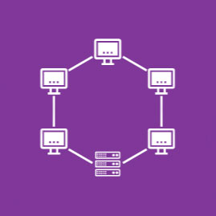
Ring Topology
Ring topology is a type of network topology in which each device is connected to two other devices on either side via an RJ-45 cable or coaxial cable.
This forms a circular ring of connected devices which gives it its name.
Data is commonly transferred in one direction along the ring, known as a unidirectional ring.
The data is forwarded from one device to the next, until it reaches the intended destination. In a bidirectional ring, data can travel in either direction.

Slide 9
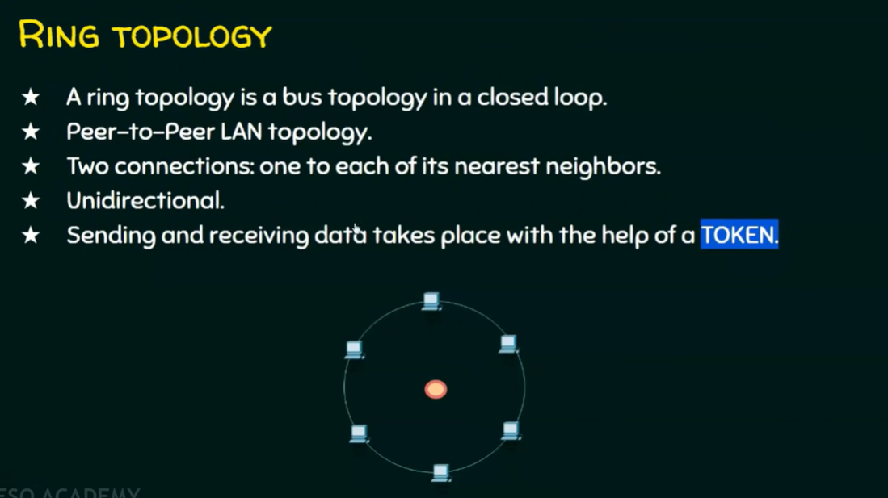

Slide 10
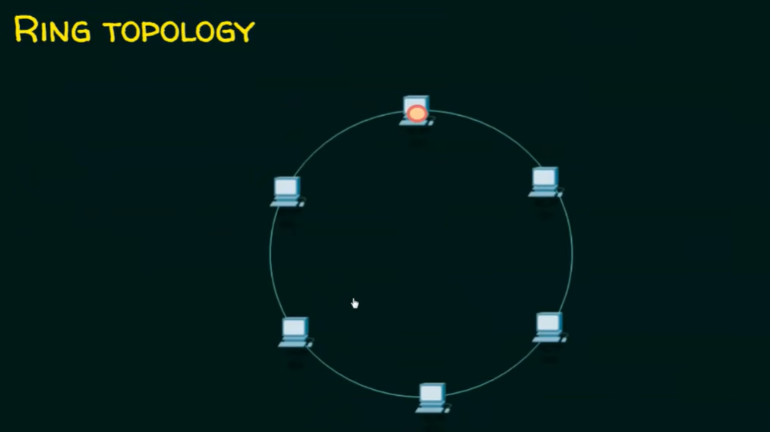
How does Token work?

Slide 11
Types of Ring topology
There are multiple types of ring topologies that provide redundancy, including:
Counter-rotating ring topology. An additional ring is present in the opposite direction of the initial ring. If a network switch fails, the backup ring is activated which allows data to continue to transmit in the network.
Collapsed ring topology. If a device fails, the ring will “collapse” and connect every other device to each other, eliminating the single point of failure and isolating it for easier maintenance.

Slide 12
Advantages
Since data flows in one direction, the chance of a packet collision is reduced
A network server is not needed to control network connectivity
Devices can be added without impacting network performance
Easy to identify and isolate single points of failure
Better suited for high traffic environments than a bus topology

Slide 13

Disadvantages
All data travelling over the network must pass through each device on its way to its destination, which can reduce performance
If one device fails, the entire network is impacted
Can be difficult to architect the necessary cabling
More expensive to implement than a bus topology

Slide 14
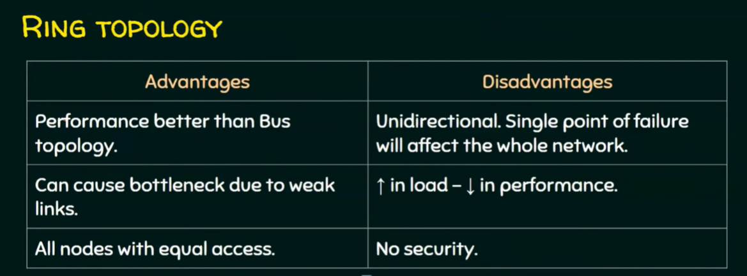
Cont..

Slide 15
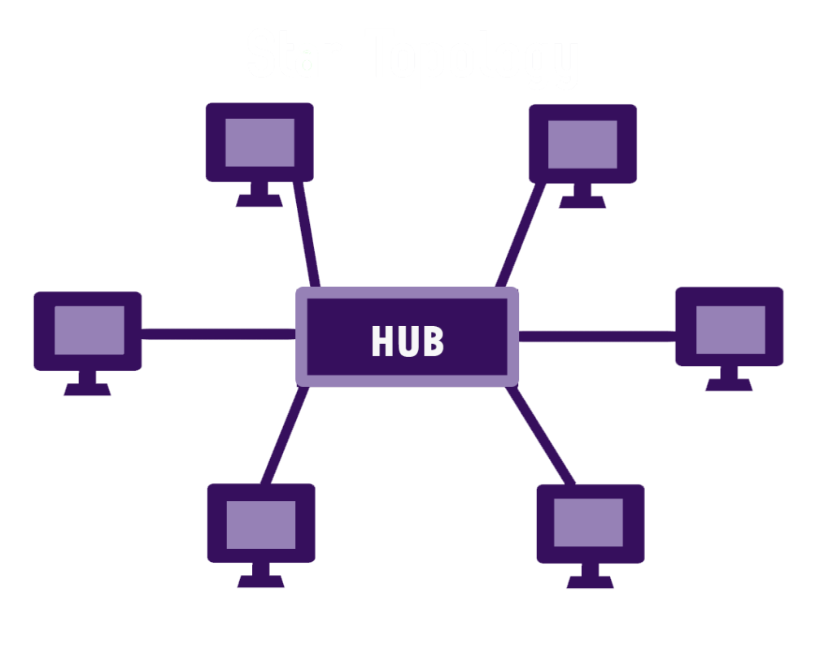
Star topology
Alternatively referred to as a star network, star topology is one of the most common network setups. Every node connects to a central network device in this configuration, like a hub, switch, or computer.
The central network device acts as a server, and the peripheral devices act as clients.
In a star topology setup, either a coaxial or RJ-45 network cable is used, depending on each computer's type of network card.
The image shows how this network setup gets its name, as it is shaped like a star.

Slide 16
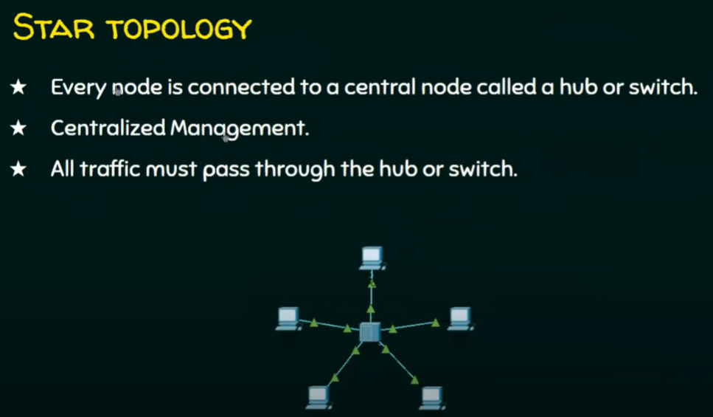

Slide 17
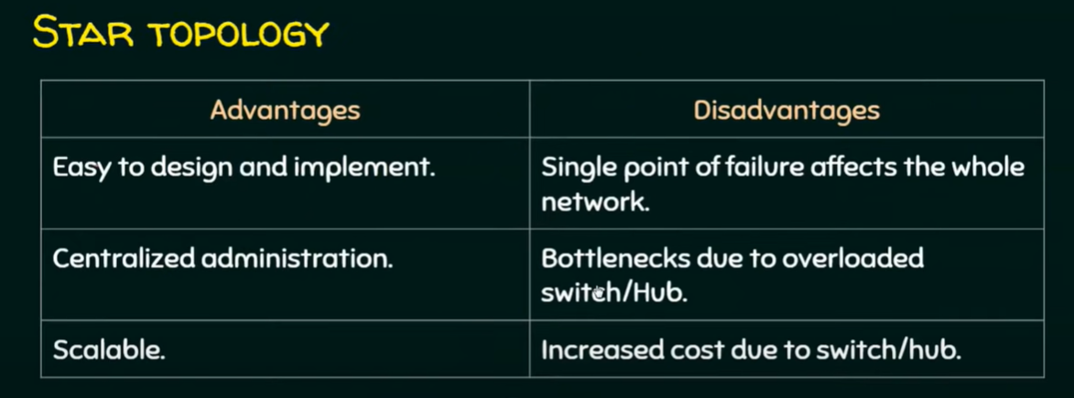
Cont..

Slide 18

Advantages
Centralized management of the network through the use of the central computer, hub, or switch.
Easy to add another computer to the network.
If one computer on the network fails, the rest of the network continues to function normally.

Slide 19
Disadvantages
It may have a higher cost to implement, especially when using a switch or router as the central network device.
The central network device determines the performance and number of nodes the network can handle.
If the central computer, hub, or switch fails, the entire network goes down, and all computers are disconnected from the network.

Slide 20
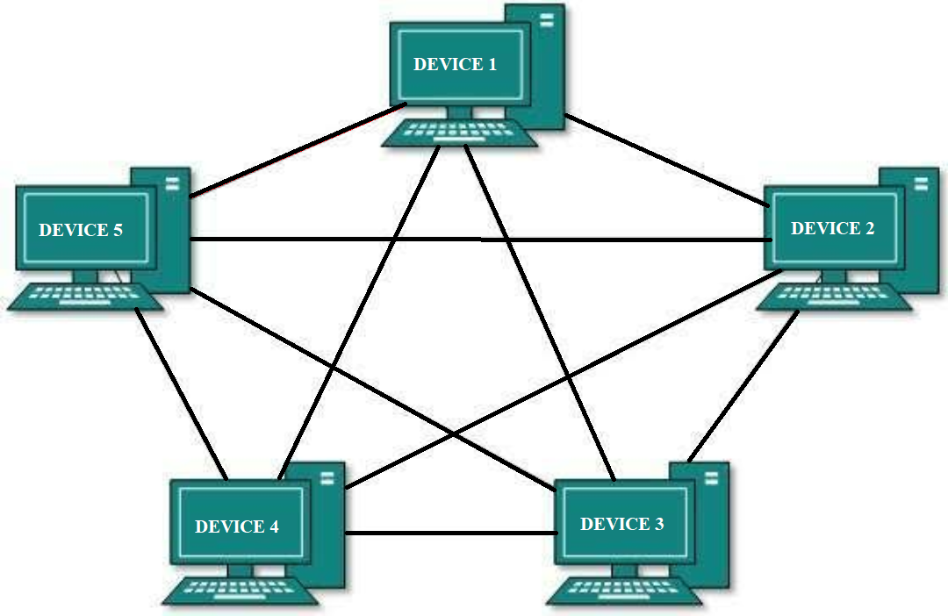
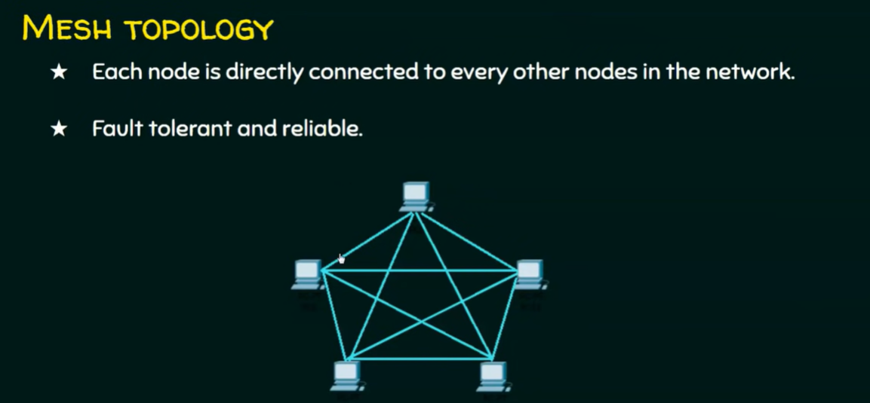
Mesh topology

Slide 21
Types of mesh topology
Full mesh and
a partially-connected mesh.

Slide 22
Full mesh
In a full mesh topology, every computer in the network has a connection to each of the other computers in that network.
The number of connections in this network can be calculated using the following formula (n is the number of computers in the network): n(n-1)/2

Slide 23
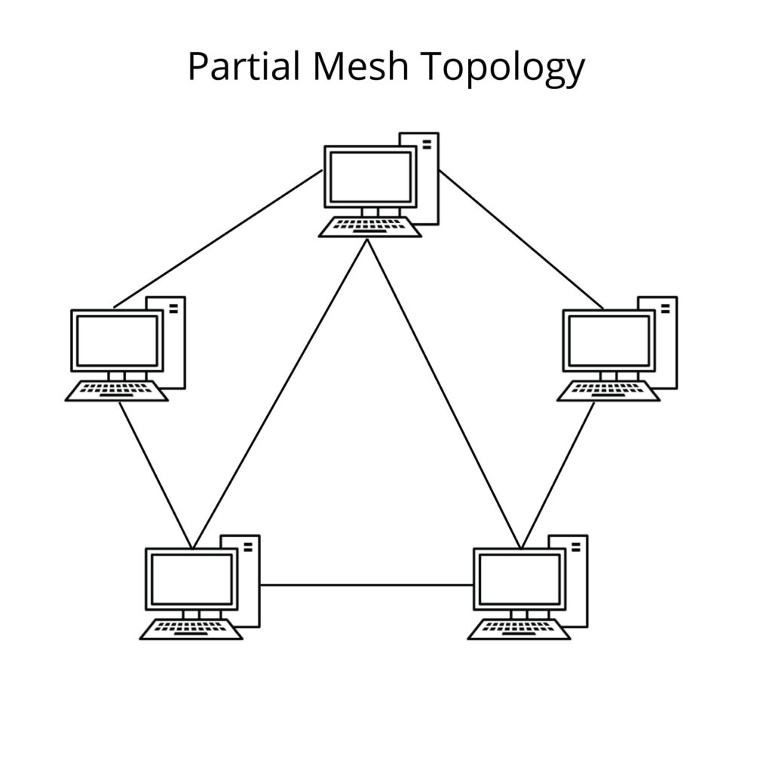
Partially mesh
In a partially-connected mesh topology, at least two of the computers in the network have connections to multiple other computers in that network.
It is an inexpensive way to implement redundancy in a network. If one of the primary computers or connections in the network fails, the rest of the network continues to operate normally.

Slide 24
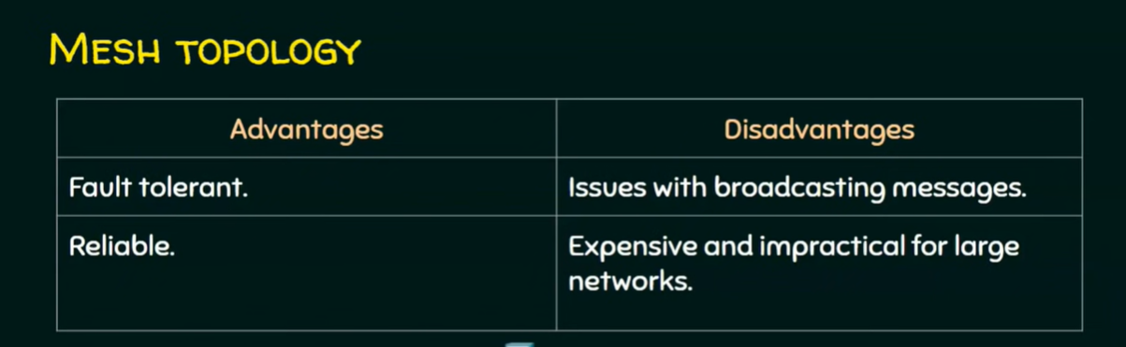

Slide 25
Advantages
Manages high amounts of traffic, because multiple devices can transmit data simultaneously.
A failure of one device does not cause a break in the network or transmission of data.
Adding additional devices does not disrupt data transmission between other devices.

Slide 26
Disadvantages
The cost to implement is higher than other network topologies, making it a less desirable option.
Building and maintaining the topology is difficult and time consuming.
The chance of redundant connections is high, which adds to the high costs and potential for reduced efficiency.

Slide 27
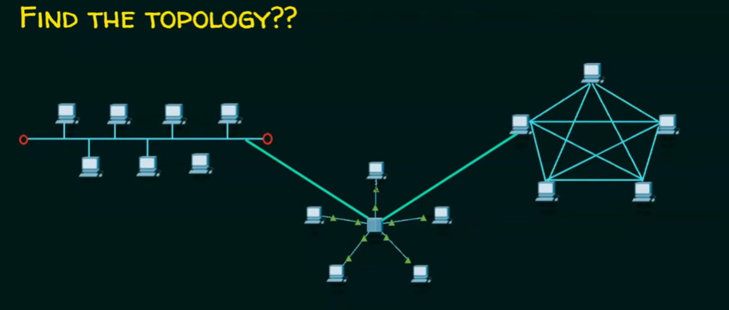

Slide 28
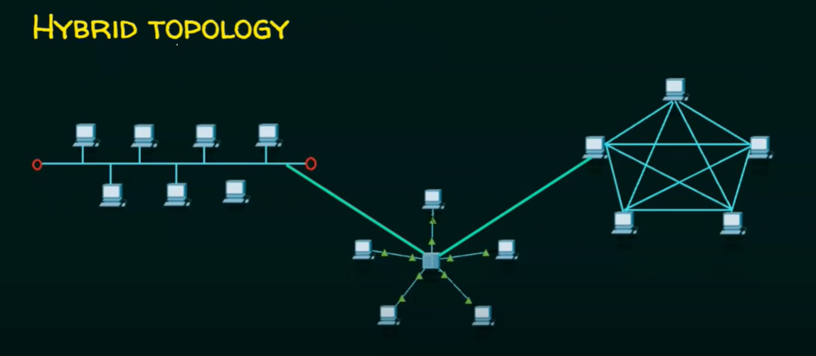

Slide 29
Tree topology
A tree topology is a special type of structure where many connected elements are arranged like the branches of a tree.
For example, tree topologies are frequently used to organize the computers in a corporate network, or the information in a database.
In a tree topology, there can be only one connection between any two connected nodes.
Because any two nodes can have only one mutual connection, tree topologies create a natural parent and child hierarchy.

Slide 30
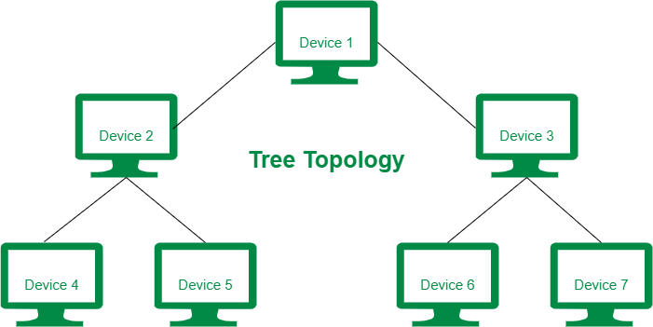
Example

Slide 31
